Slide 1


MULTIMEDIA SOFTWARE
SPLINE

Slide 2
AGENDA:
INTRODUCTION
AND REASONS FOR CREATION OF SPLINE
01
Features offered by spline.
02
Advantages and disadvantages.
03

Slide 3
INTRODUCTION
Spline is a free 3D design software with real-time collaboration to create web interactive experiences in the browser. Easy 3d modeling, animation.

Slide 4
reasons
1. Spline is primarily used for 3D modeling.
2. It meant to generate or design 3D objects for web interfaces.
3. Provide easy 3D modeling software

Slide 5
AGENDA:
Features offered by spline.
02
Advantages and disadvantages.
03
INTRODUCTION
AND REASONS FOR CREATION OF SPLINE
01

Slide 6
Features offered by spline.
Drawing Tools: Spline has Vector tools for creating drawings or designs.
Scenes: Support for organizing content into Scenes, enabling users to manage and edit different elements independently.
Color Palette: Options for selecting colors, gradients, and textures to apply to designs.

Slide 7
Features offered by spline.
Undo/Redo: The ability to undo and redo actions to experiment with different design choices.
Import/Export: Support for importing external assets or exporting completed designs in various file formats.
Transformations: Tools for scaling, rotating, and flipping elements within the canvas.
Text Tools: Options for adding and formatting text within the design.

Slide 8
Features offered by spline.
Collaboration Features: If it's an online tool, collaborative features like real-time editing or sharing designs with others.
Customization: Options to customize the workspace, toolbars, and shortcuts according to user preferences.
Effects and Filters: Filters or effects to enhance or modify the appearance of elements.

Slide 9
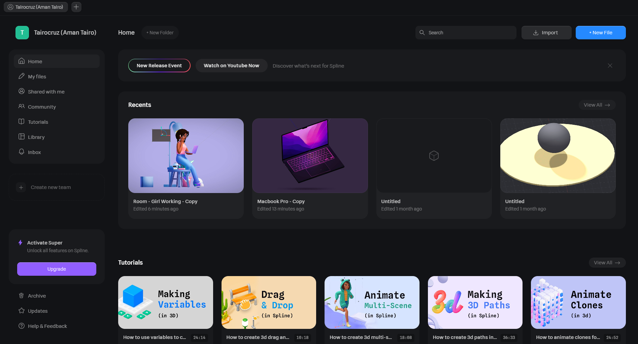
Features offered by spline.

Slide 10
AGENDA:
Features offered by spline.
02
Advantages and disadvantages.
03
INTRODUCTION
AND REASONS FOR CREATION OF SPLINE
01

Slide 11
Advantages.
Real time Collaboration: Spline enable a designer to collaborate with spline community on a given project, it offers a real-time editing or sharing designs with others.
Interactive experiences: you can interactivity in your objact.
Its simple to learn than full featured 3D apps that are cinema4D and blender, hence its designed to replace them.

Slide 12
Dis Advantages.
Networks dependance: spline it not work offline, such that it need to be online in order to use it.
Hardware requirements: it requires a good graphics cards and sufficient RAM so that for effectively functioning.

Slide 13
Dis Advantages.
THANK YOU

